Slide 1
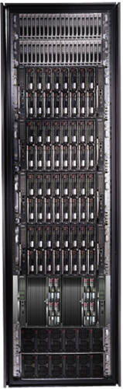
Programming clusters with DryadLINQ
Mihai Budiu Microsoft Research, Silicon Valley
Association of C and C++ Users (ACCU)
Mountain View, CA, April 13, 2011

Slide 2

Goal
Notes:
Enable any programmer to write and run applications on small and large computer clusters.

Slide 3
Design Space
Grid
Internet
Data-
parallel
Search
Dryad
Shared
memory
Data
center
Transaction
HPC
Latency
(interactive)
Throughput
(batch)
Notes:
Dryad is optimized for: throughput, data-parallel computation, in a private data-center.

Slide 4
Data-Parallel Computation
Application
SQL
Sawzall, Java
≈SQL
LINQ, SQL
Parallel Databases
Sawzall,FlumeJava
Pig, Hive
DryadLINQ Scope
Language
Map-Reduce
Hadoop
Dryad
Execution
GFS BigTable
HDFS
S3
Cosmos
Azure SQL Server
Storage

Slide 5
Software Stack: Talk Outline
Applications
DryadLINQ
Dryad
Cluster storage
Cluster services
Windows Server
Windows Server
Windows Server
Windows Server

Slide 6
DRYAD
Applications
DryadLINQ
Dryad
Cluster storage
Cluster services
Windows Server
Windows Server
Windows Server
Windows Server

Slide 7
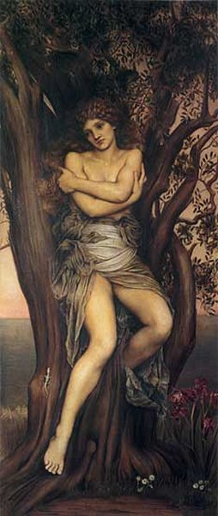
Dryad
Continuously deployed since 2006
Running on >> 10⁴ machines
Sifting through > 10Pb data daily
Runs on clusters > 3000 machines
Handles jobs with > 10⁵ processes each
Platform for rich software ecosystem
Used by >> 100 developers
Written at Microsoft Research, Silicon Valley
The Dryad by Evelyn De Morgan.

Slide 8
Dryad = Execution Layer
Job (application)
Pipeline
≈
Dryad
Shell
Cluster
Machine
Notes:
In the same way as the Unix shell does not understand the pipeline running on top, but manages its execution (i.e., killing processes when one exits), Dryad does not understand the job running on top.

Slide 9

2-D Piping
Unix Pipes: 1-D
grep | sed | sort | awk | perl
Dryad: 2-D
grep¹⁰⁰⁰ | sed⁵⁰⁰ | sort¹⁰⁰⁰ | awk⁵⁰⁰ | perl⁵⁰
Notes:
Dryad is a generalization of the Unix piping mechanism: instead of uni-dimensional (chain) pipelines, it provides two-dimensional pipelines. The unit is still a process connected by a point-to-point channel, but the processes are replicated.

Slide 10
Virtualized 2-D Pipelines
Notes:
This is a possible schedule of a Dryad job using 2 machines.

Slide 11


Virtualized 2-D Pipelines

Slide 12

Virtualized 2-D Pipelines

Slide 13
Virtualized 2-D Pipelines

Slide 14
Virtualized 2-D Pipelines
2D DAG
multi-machine
virtualized
Notes:
The Unix pipeline is generalized 3-ways:
2D instead of 1D
spans multiple machines
resources are virtualized: you can run the same large job on many or few machines

Slide 15
Dryad Job Structure
Channels
Input files
Stage
Output files
grep
sort
awk
sed
perl
grep
sort
sed
awk
grep
sort
Vertices (processes)
Notes:
This is the basic Dryad terminology.

Slide 16
Channels
Finite streams of items
distributed filesystem files (persistent)
SMB/NTFS files (temporary)
TCP pipes (inter-machine)
memory FIFOs (intra-machine)
X
Items
M
Notes:
Channels are very abstract, enabling a variety of transport mechanisms.
The performance and fault-tolerance of these machanisms vary widely.

Slide 17
Dryad System Architecture
data plane
Files, TCP, FIFO, Network
job schedule
V
V
V
NS, Sched
RE
RE
RE
control plane
Job manager
cluster
Notes:
The brain of a Dryad job is a centralized Job Manager, which maintains a complete state of the job.
The JM controls the processes running on a cluster, but never exchanges data with them.
(The data plane is completely separated from the control plane.)

Slide 18



Fault Tolerance
Notes:
Vertex failures and channel failures are handled differently.

Slide 19
DRYADLINQ
Applications
DryadLINQ
Dryad
Cluster storage
Cluster services
Windows Server
Windows Server
Windows Server
Windows Server

Slide 20

LINQ
=> DryadLINQ
Dryad
Notes:
DryadLINQ adds a wealth of features on top of plain Dryad.

Slide 21
LINQ = .Net+ Queries
Collection<T> collection;
bool IsLegal(Key);
string Hash(Key);
var results = from c in collection where IsLegal(c.key) select new { Hash(c.key), c.value};
Notes:
Language Integrated Query is an extension of .Net which allows one to write declarative computations on collections (green part).

Slide 22
Collections and Iterators
class Collection<T> : IEnumerable<T>;
Iterator
(current element)
Elements of type T

Slide 23

DryadLINQ Data Model
.Net objects
Partition
Collection

Slide 24

DryadLINQ = LINQ + Dryad
Collection<T> collection;
bool IsLegal(Key k);
string Hash(Key);
var results = from c in collection where IsLegal(c.key) select new { Hash(c.key), c.value};
Vertex code
Query plan
(Dryad job)
Data
collection
C#
C#
C#
C#
results
Notes:
DryadLINQ translates LINQ programs into Dryad computations:
- C# and LINQ data objects become distributed partitioned files.
- LINQ queries become distributed Dryad jobs.
- C# methods become code running on the vertices of a Dryad job.

Slide 25
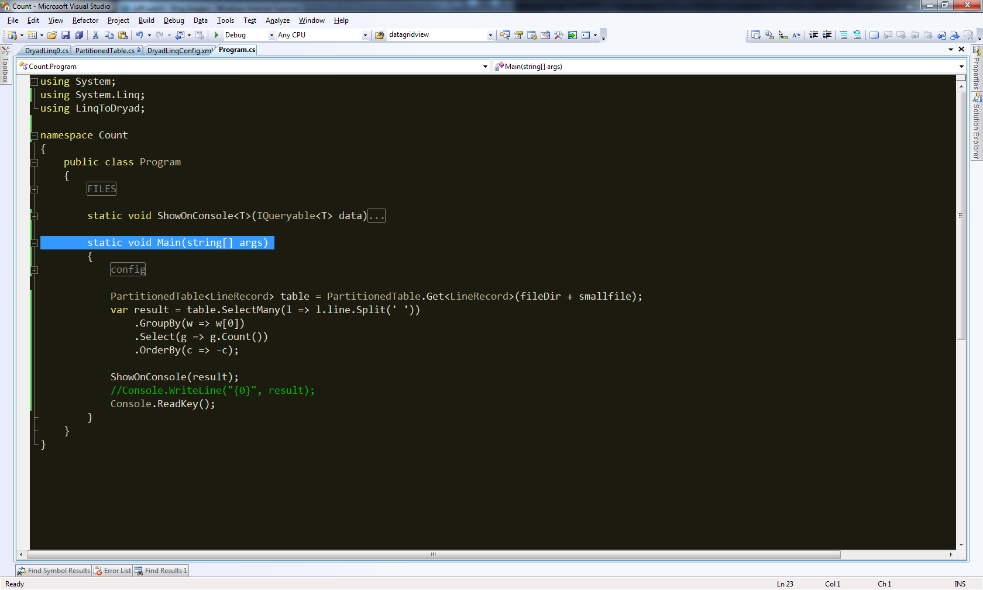
Demo

Slide 26
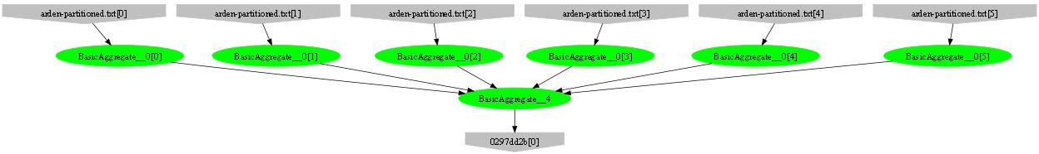
Example: counting lines
var table = PartitionedTable.Get<LineRecord>(file);
int count = table.Count();
Parse, Count
Sum

Slide 27
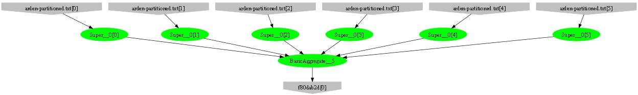
Example: counting words
var table = PartitionedTable.Get<LineRecord>(file);
int count = table .SelectMany(l => l.line.Split(‘ ‘))
.Count();
Parse, SelectMany, Count
Sum

Slide 28
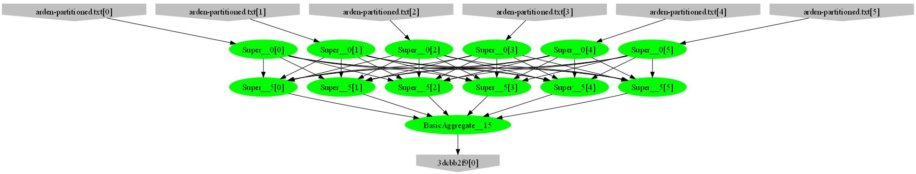
Example: counting unique words
var table = PartitionedTable.Get<LineRecord>(file);
int count = table .SelectMany(l => l.line.Split(‘ ‘))
.GroupBy(w => w)
.Count();
HashPartition
GroupBy;
Count

Slide 29
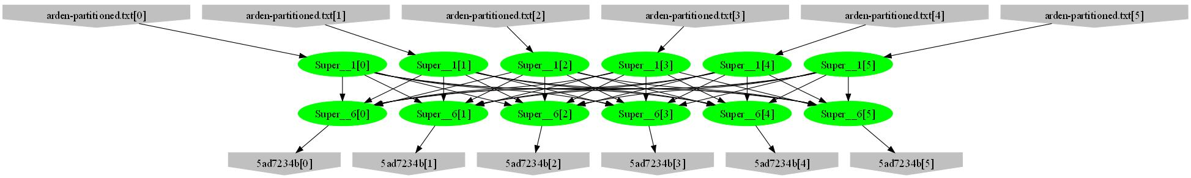
Example: word histogram
var table = PartitionedTable.Get<LineRecord>(file);
var result = table.SelectMany(l => l.line.Split(' '))
.GroupBy(w => w)
.Select(g => new { word = g.Key, count = g.Count() });
GroupBy
Count
HashPartition
GroupBy;
Count

Slide 30
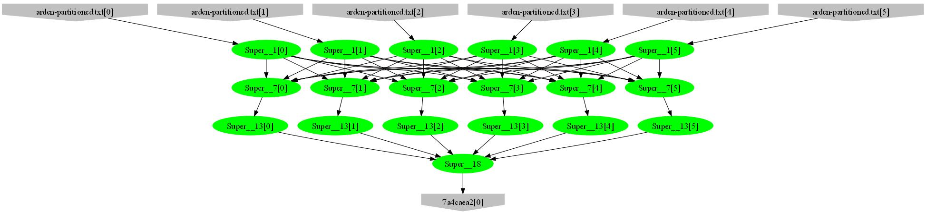
Example: high-frequency words
var table = PartitionedTable.Get<LineRecord>(file);
var result = table.SelectMany(l => l.line.Split(' '))
.GroupBy(w => w)
.Select(g => new { word = g.Key, count = g.Count() })
.OrderByDescending(t => t.count)
.Take(100);
Sort; Take
Mergesort; Take

Slide 31
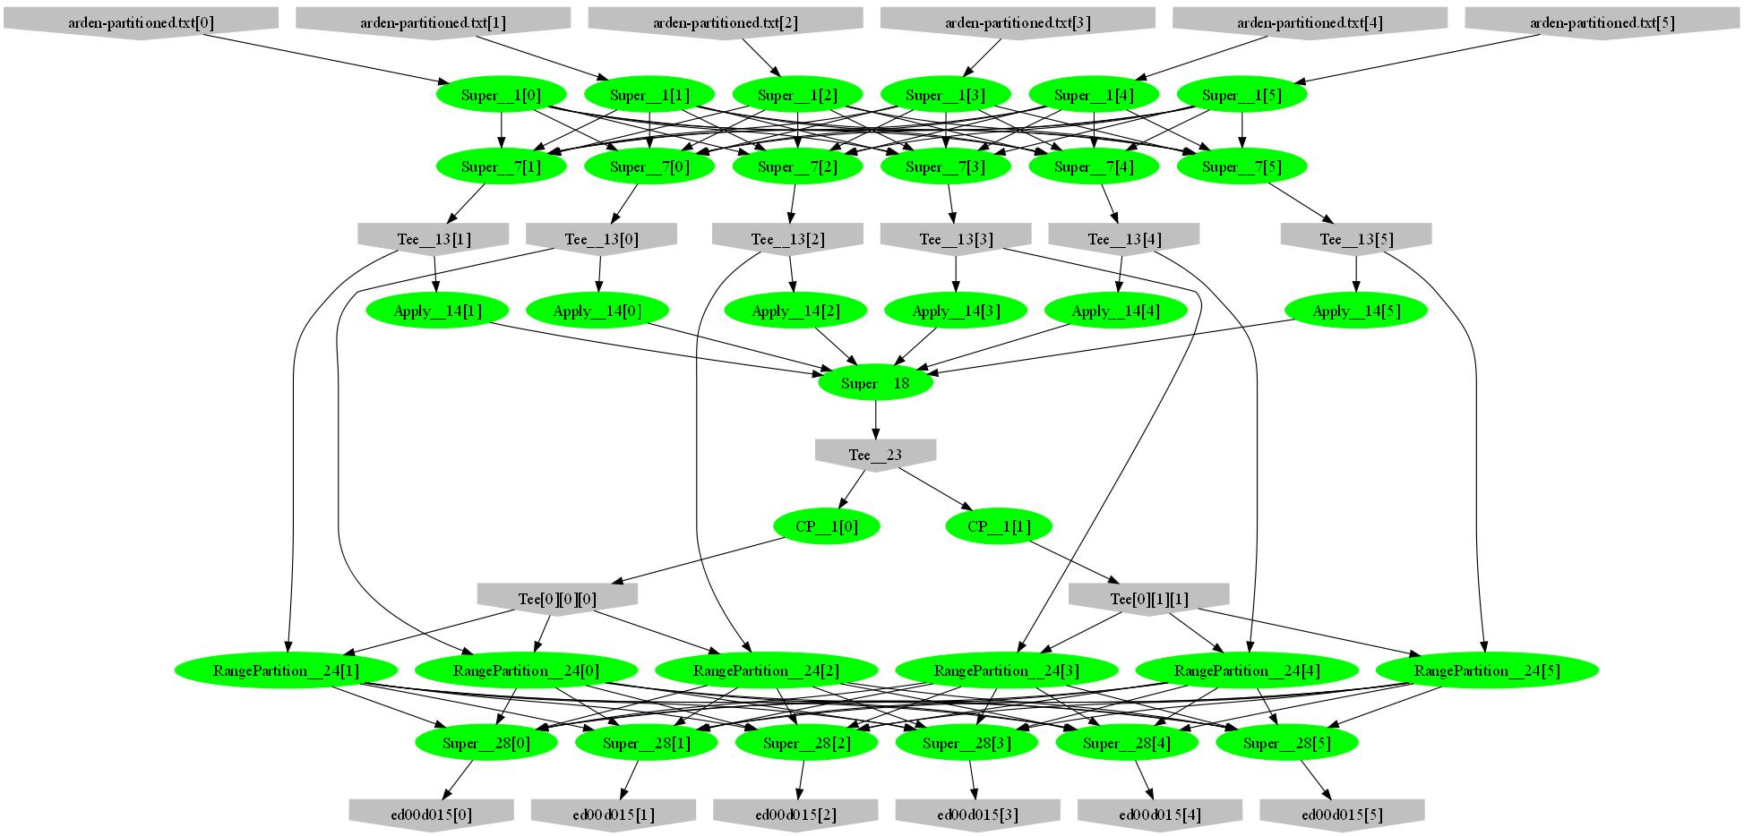
Example: words by frequency
var table = PartitionedTable.Get<LineRecord>(file);
var result = table.SelectMany(l => l.line.Split(' '))
.GroupBy(w => w)
.Select(g => new { word = g.Key, count = g.Count() })
.OrderByDescending(t => t.count);
Sample
Histogram
Broadcast
Range-partition
Sort

Slide 32
Example: Map-Reduce
public static IQueryable<S> MapReduce<T,M,K,S>(
IQueryable<T> input,
Func<T, IEnumerable<M>> mapper,
Func<M,K> keySelector,
Func<IGrouping<K,M>,S> reducer)
{
var map = input.SelectMany(mapper);
var group = map.GroupBy(keySelector);
var result = group.Select(reducer);
return result;
}

Slide 33
Map-Reduce Plan
M
M
M
M
M
M
M
map
Q
Q
Q
Q
Q
Q
Q
sort
G₁
G₁
G₁
G₁
G₁
G₁
G₁
groupby
map
M
R
R
R
R
R
R
R
reduce
D
D
D
D
D
D
D
distribute
G
R
MS
MS
MS
MS
MS
mergesort
groupby
X
G₂
G₂
G₂
G₂
G₂
partial aggregation
R
R
R
R
R
reduce
X
X
X
MS
MS
mergesort
dynamic
G₂
G₂
groupby
reduce
R
R
reduce
X
X
consumer

Slide 34
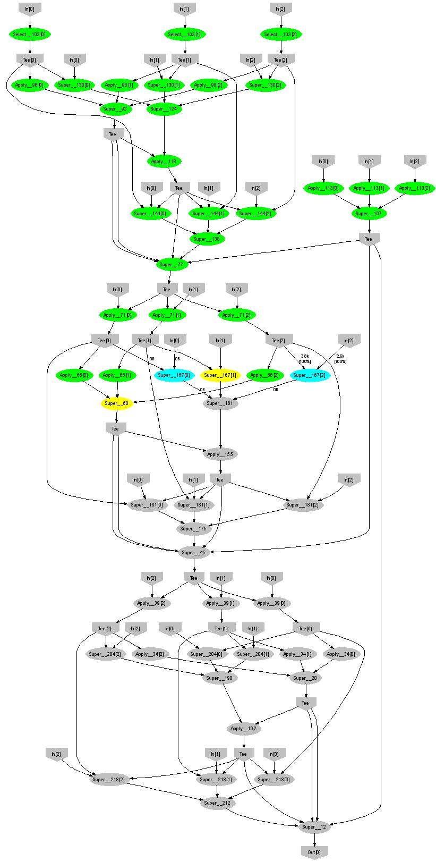
Expectation Maximization
160 lines
3 iterations shown
Notes:
More complicated, even iterative algorithms, can be implemented.

Slide 35
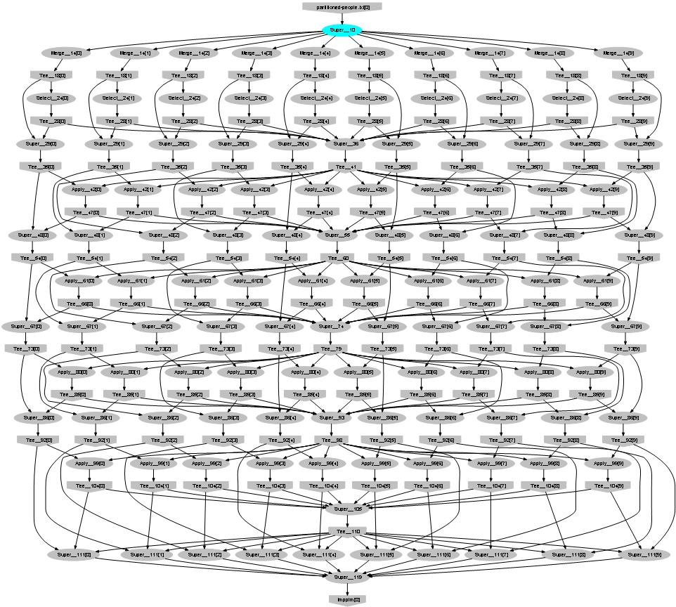
Probabilistic Index Maps
Images
features

Slide 36
Language Summary
Where
Select
GroupBy
OrderBy
Aggregate
Join

Slide 37

What Is It Good For?

Slide 38
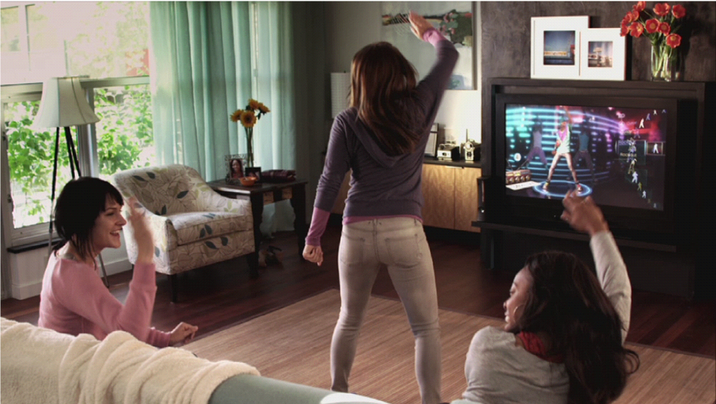
What is Kinect?

Slide 39
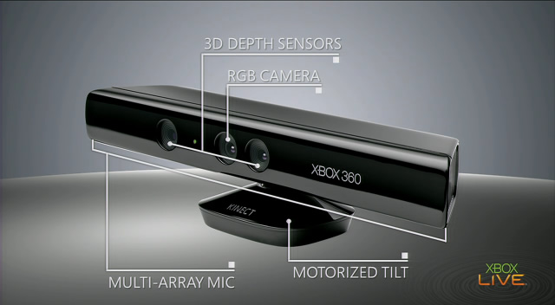
Input device

Slide 40
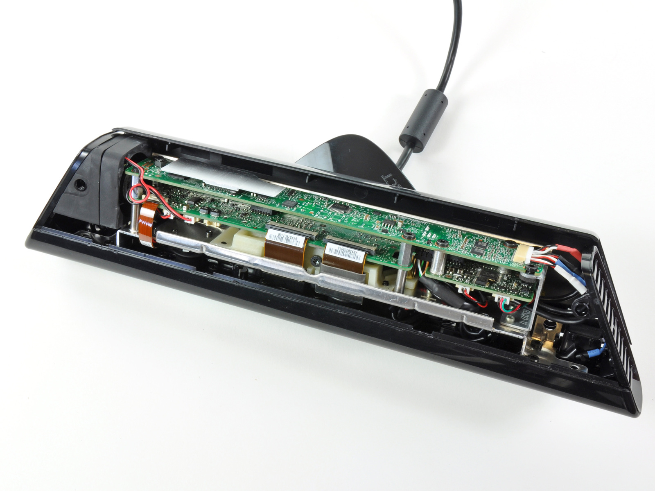
The Innards
Source: iFixit

Slide 41
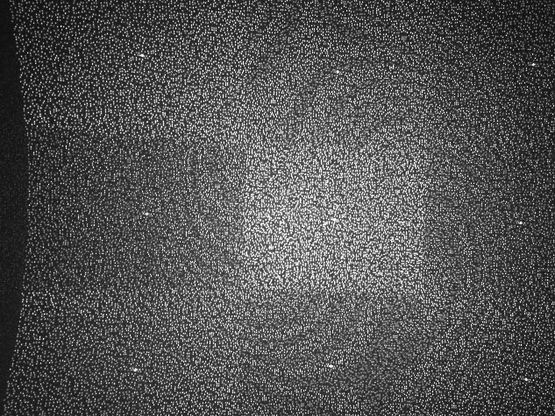
Projected IR pattern
Source: www.ros.org

Slide 42

Depth computation
Source: http://nuit-blanche.blogspot.com/2010/11/unsing-kinect-for-compressive-sensing.html

Slide 43


Kinect video output
30 HZ frame rate
57deg field-of-view
8-bit VGA RGB 640 x 480
11-bit depth 320 x 240

Slide 44
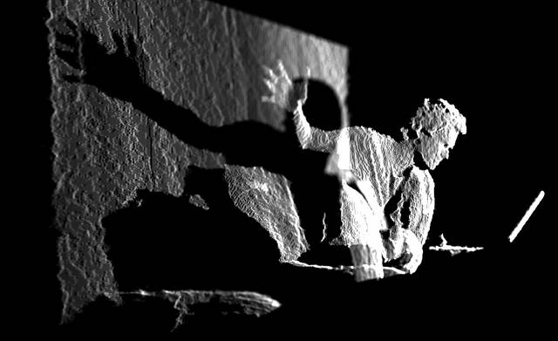
Depth map
Source: www.insidekinect.com

Slide 45
Vision Problem: What is a human
Recognize players from depth map
At frame rate
Minimal resource usage
Notes:
Image from http://r24085.ovh.net/images/Gallery/depthMap-small.jpg

Slide 46
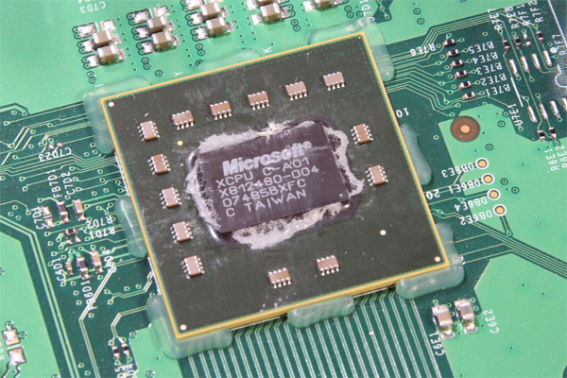
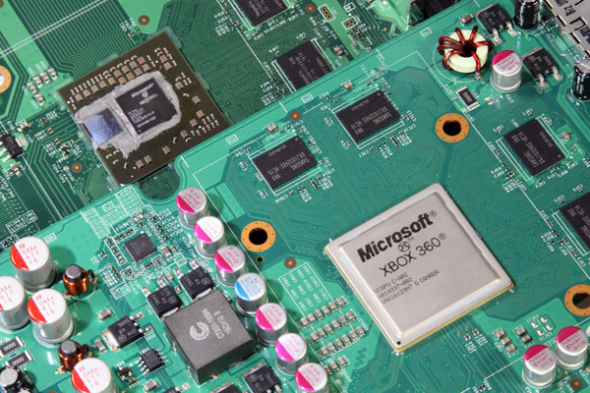
XBox 360 Hardware
Triple Core PowerPC 970, 3.2GHz
Hyperthreaded, 2 threads/core
500 MHz ATI graphics card
DirectX 9.5
512 MB RAM
2005 performance envelope
Must handle
real-time vision AND
a modern game
Source: http://www.pcper.com/article.php?aid=940&type=expert

Slide 47


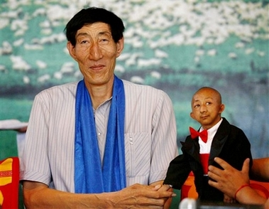
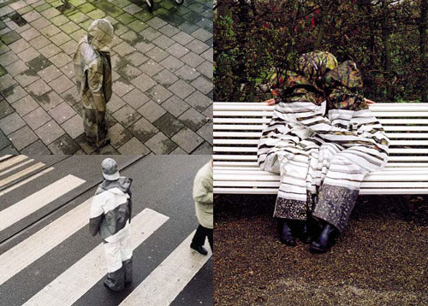

Why is it hard?

Slide 48
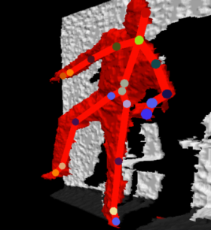

Generic Extensible Architecture
Expert 1
fuses the hypotheses
Arbiter
Expert 2
Expert 3
probabilistic
Raw
data
Skeleton
estimates
Final
estimate
Sensor
Stateless
Stateful

Slide 49

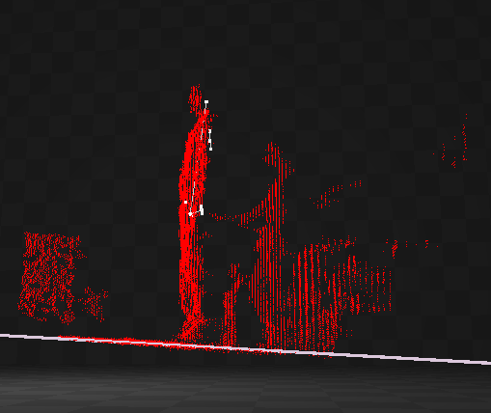
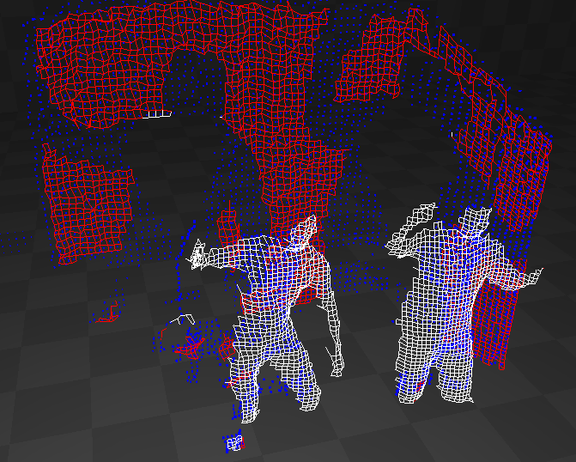
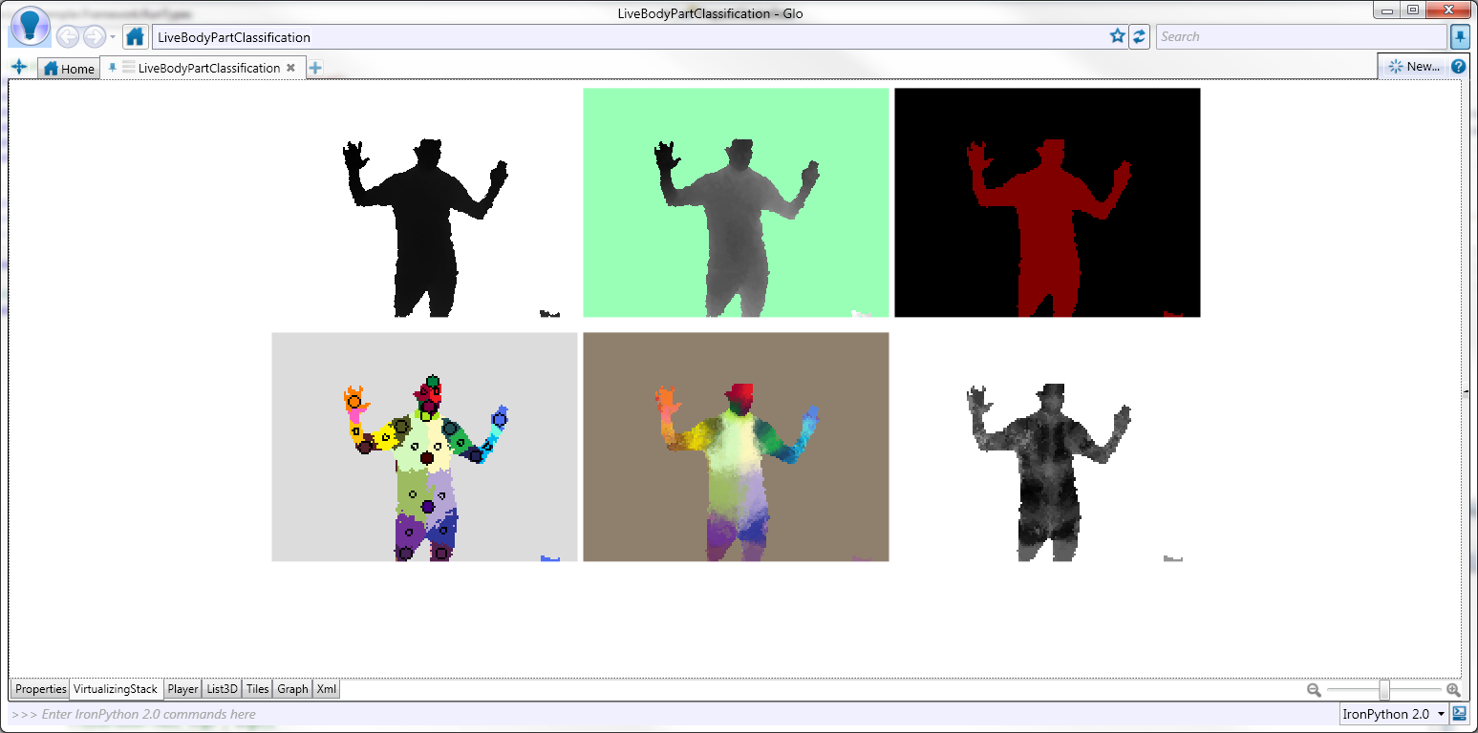


One Expert: Pipeline Stages
Sensor
Depth map
Background segmentation
Player separation
Body Part Classifier
Body Part Identification
Skeleton

Slide 50
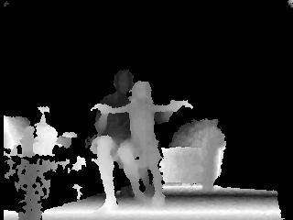
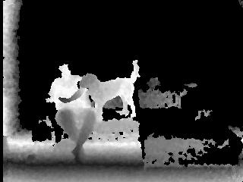
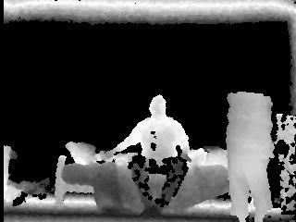
Sample test frames

Slide 51
The Classifier
Classifier
Input
Depth map
Runs on GPU @ 320x240
Output
Body parts

Slide 52
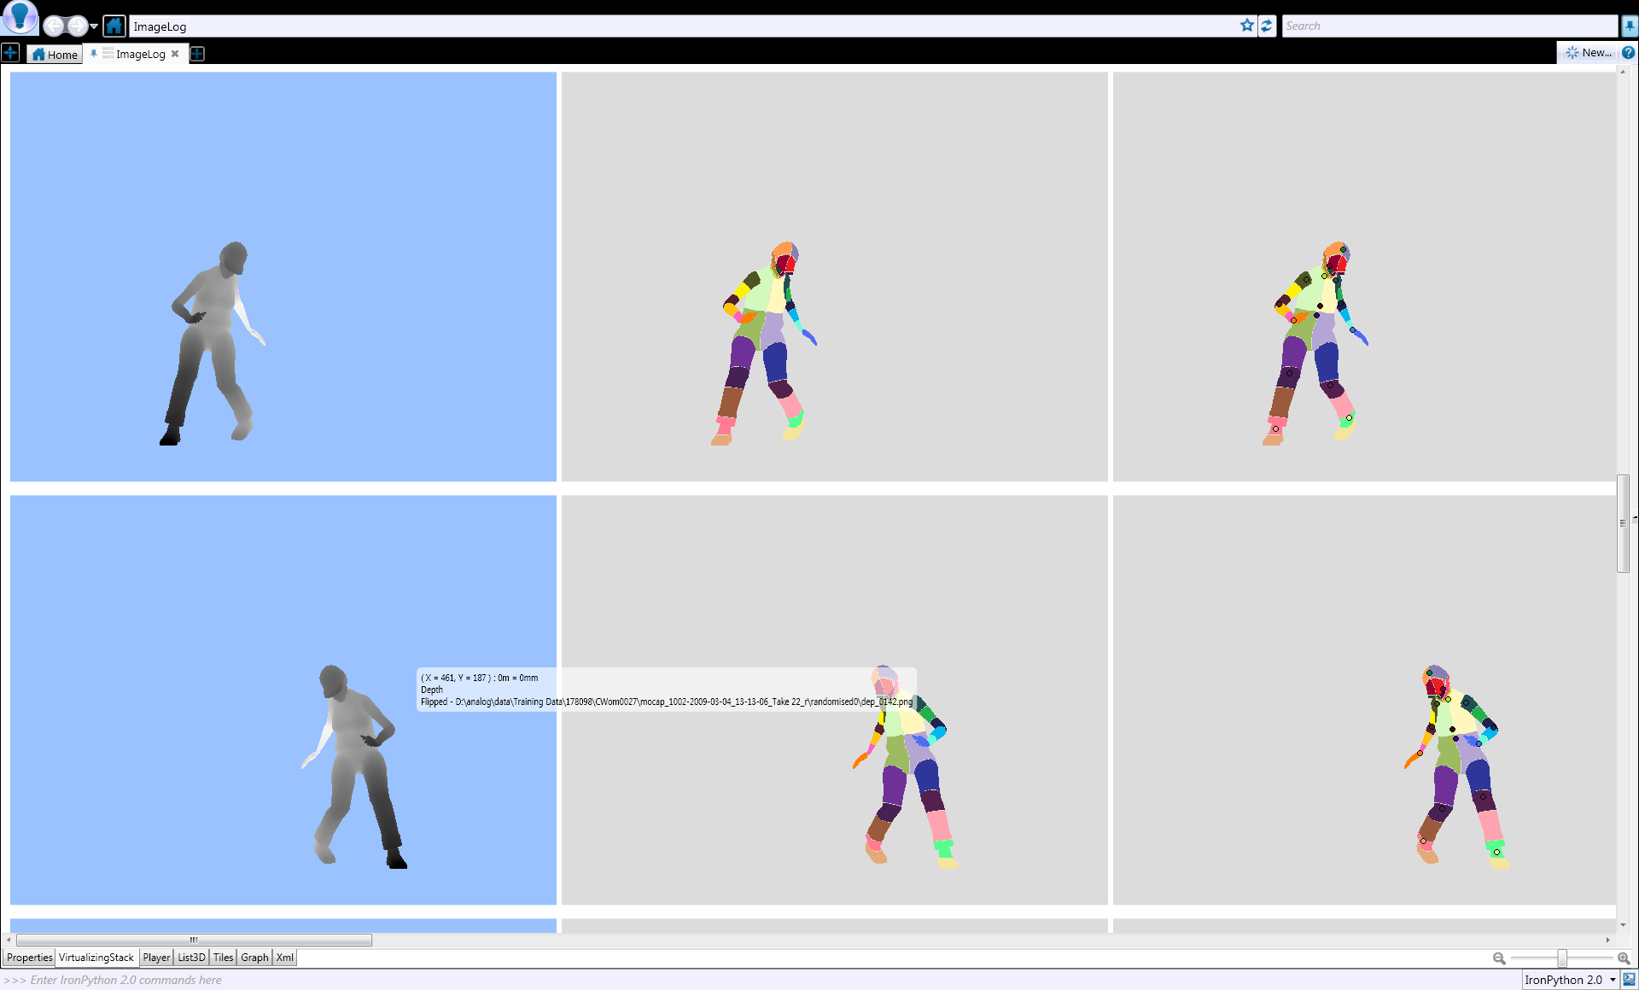
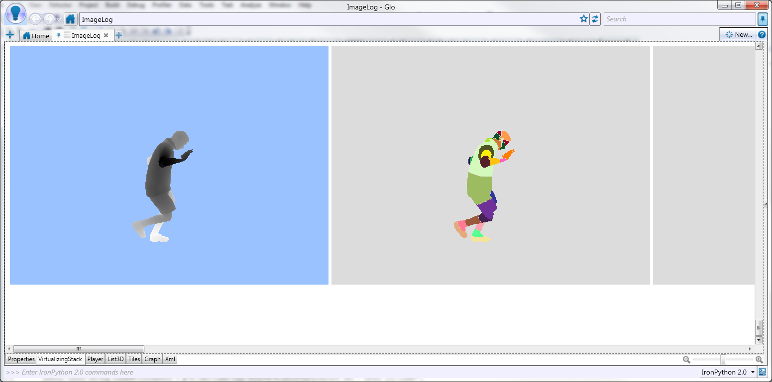
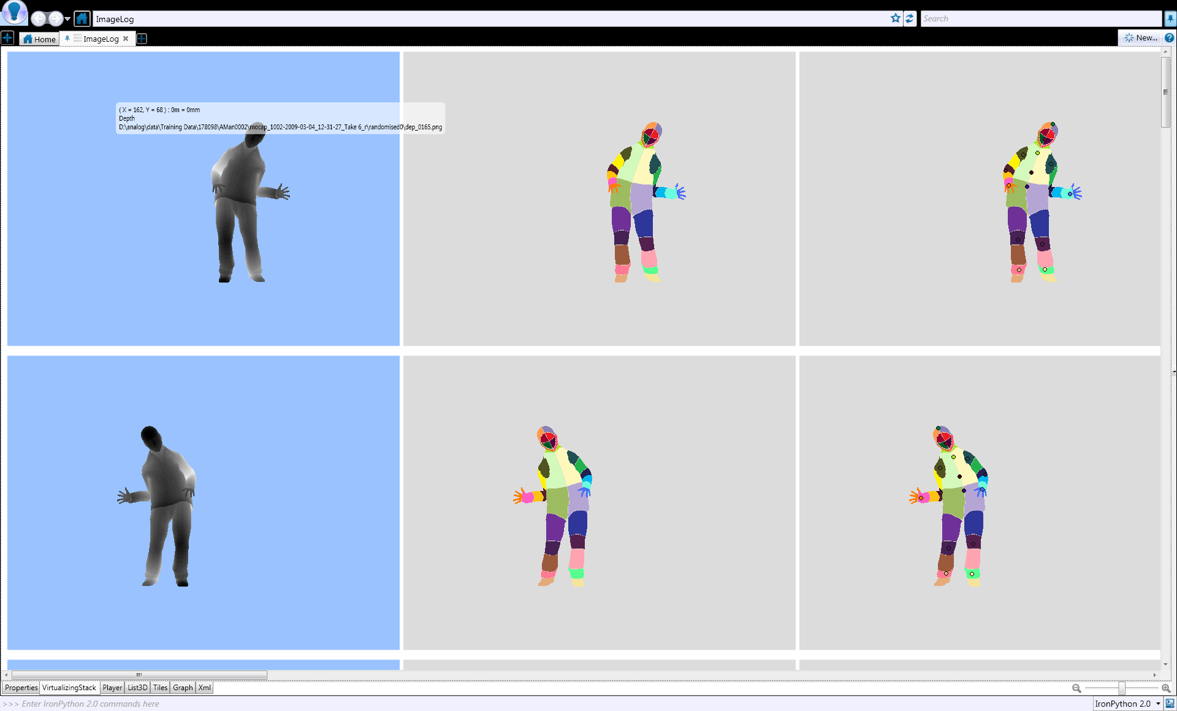
Getting the Ground Truth
Start from ground-truth data
depth paired with body parts
Train classifier to work across
pose
scene position
Height, body shape

Slide 53
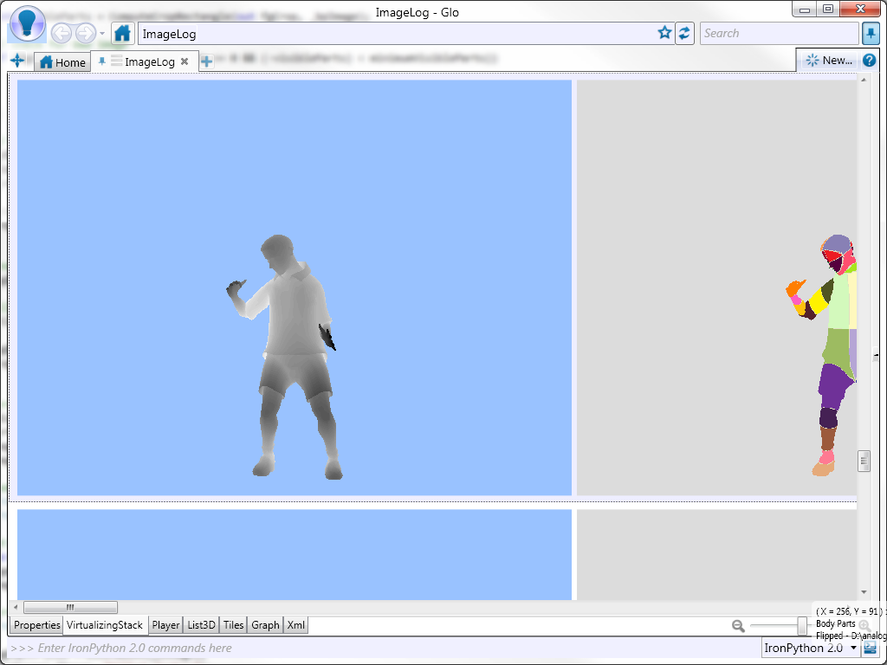
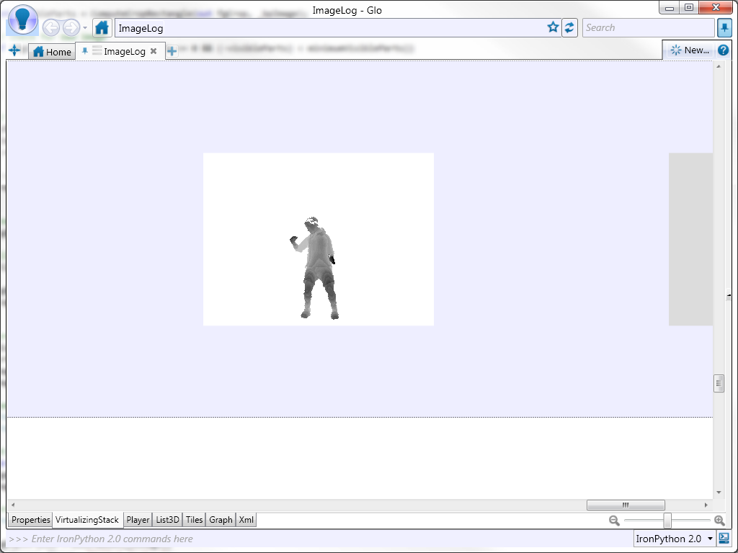
Getting the Ground Truth
Use synthetic data (3D avatar model)
Inject noise

Slide 54

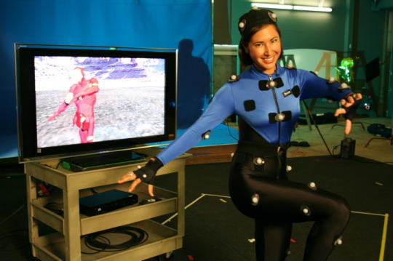
Motion capture
[Vicon]
[Xsens]
very accurate
high frame rate
suit / sensors
expensive
large space
calibration
Notes:
This is how the movie studios do things

Slide 55

Learn from Data
Training examples
Machine learning
Classifier

Slide 56
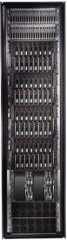
Cluster-based training
Classifier
Training examples
Machine learning
DryadLINQ
> Millions of input frames
> 10²⁰ objects manipulated
Sparse, multi-dimensional data
Complex datatypes (images, video, matrices, etc.)
Dryad

Slide 57
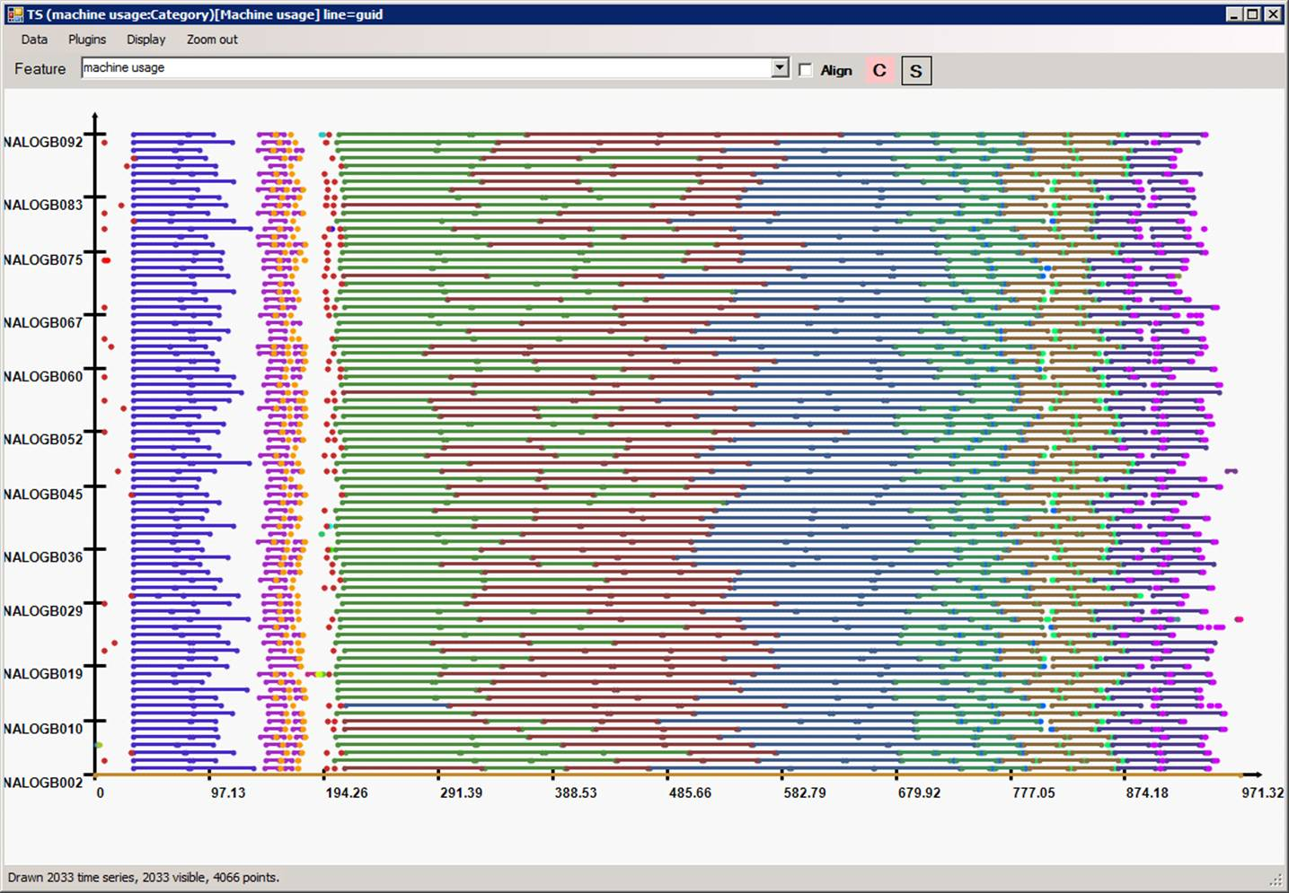
Highly efficient parallellization
machine
time

Slide 58
Conclusions

Slide 59
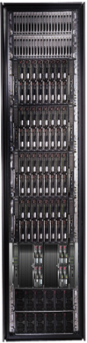
Conclusions
Cluster
LINQ
Dryad
=
59
Notes:
We believe that Dryad and DryadLINQ are a great foundation for cluster computing.

Slide 60
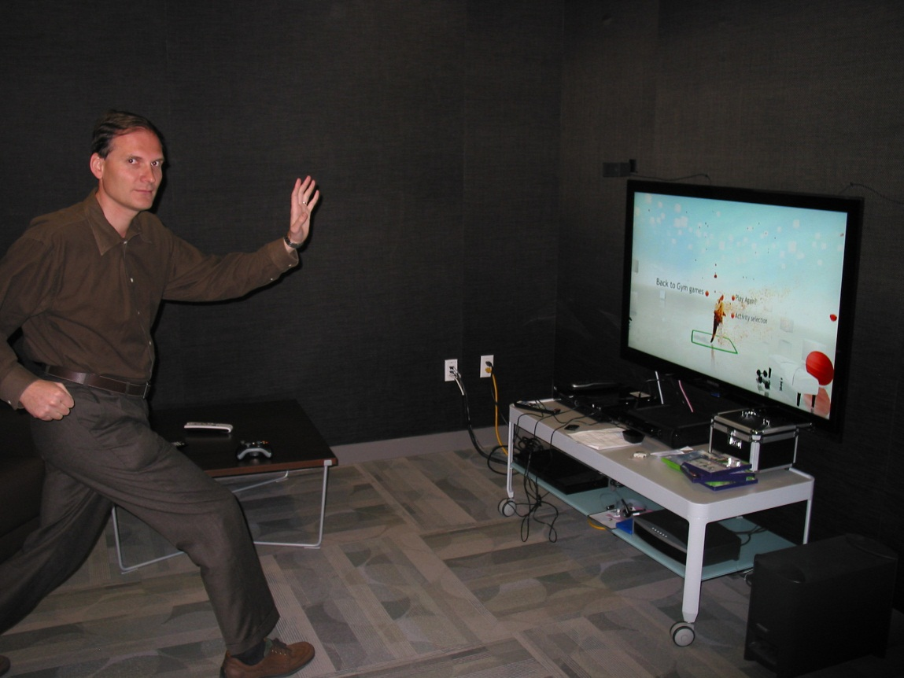
I can finally explain to my son what I do for a living…

